Slide 1
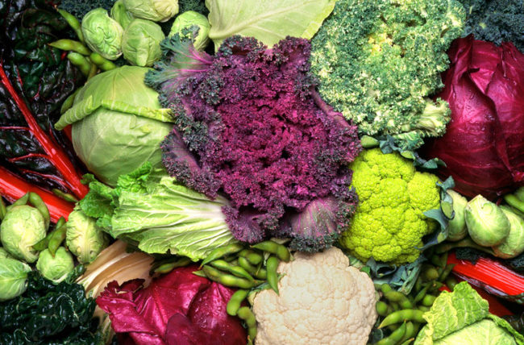
Cabbages and their cousins:
The dogs of the plant world
GRASSHOPR Lesson
Friday, April 21 2022
Merritt Khaipho-Burch

Slide 2
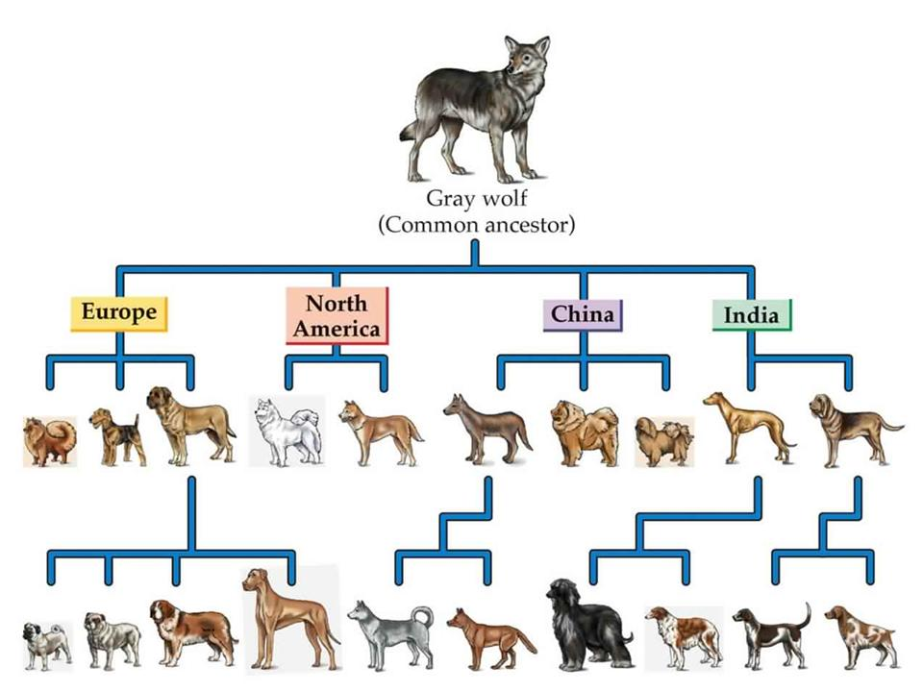
Dog domestication
Canis lupus familiaris
First species domesticated by humans 15-25k years ago in Siberia

Slide 3
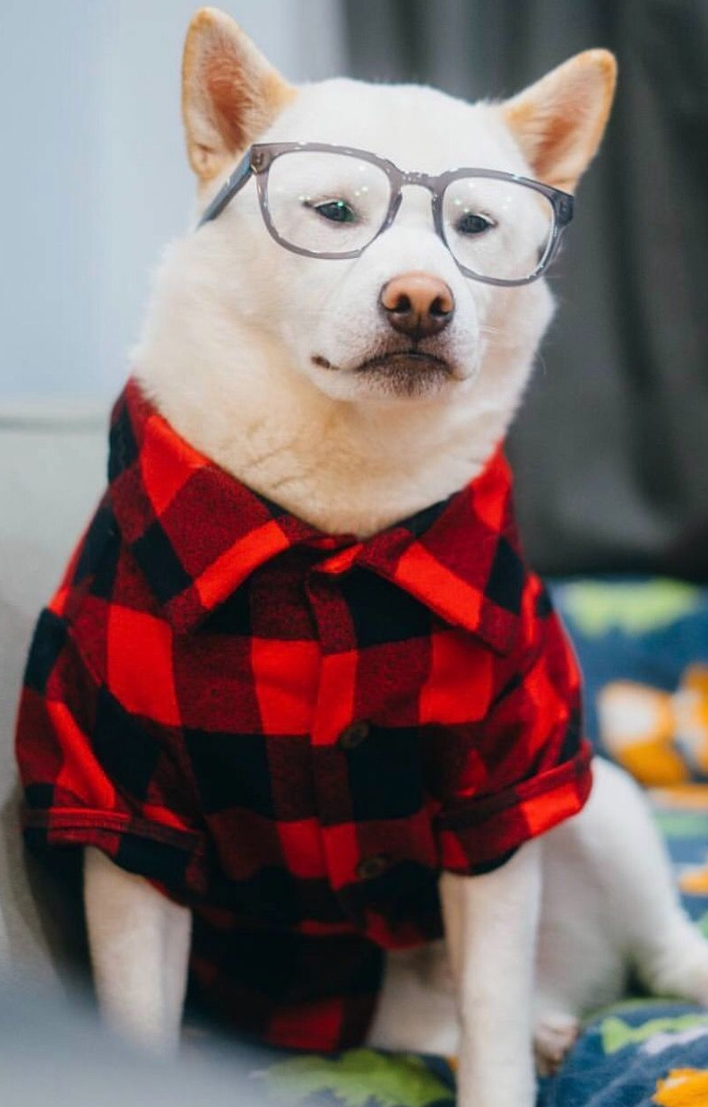
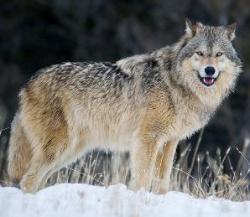
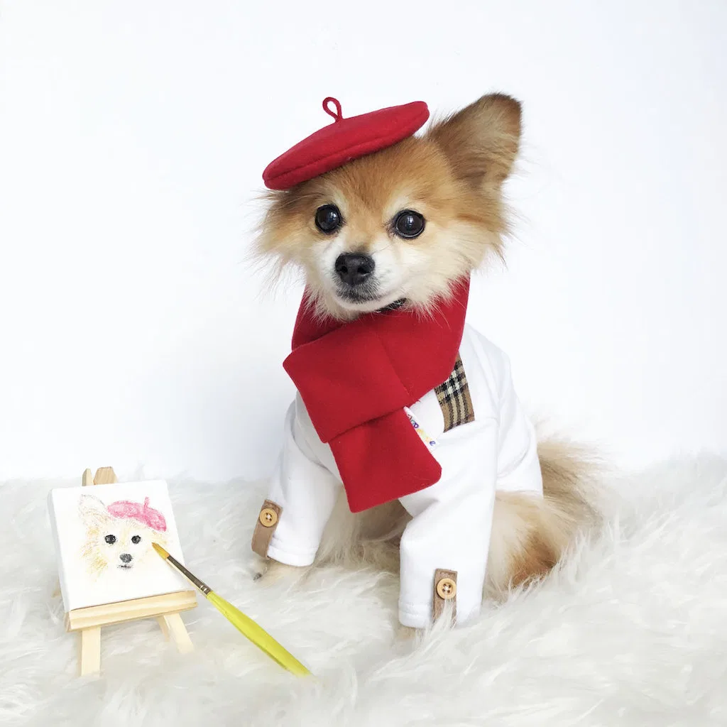
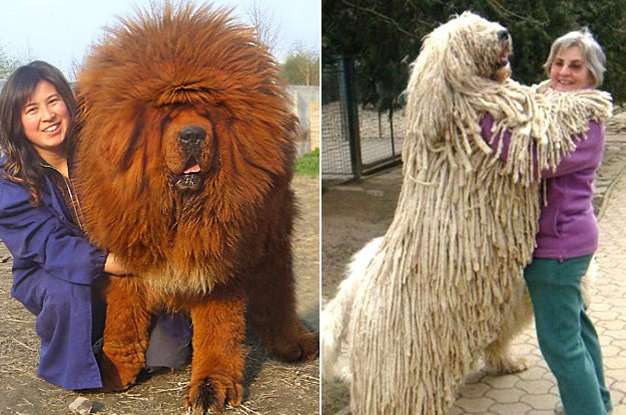
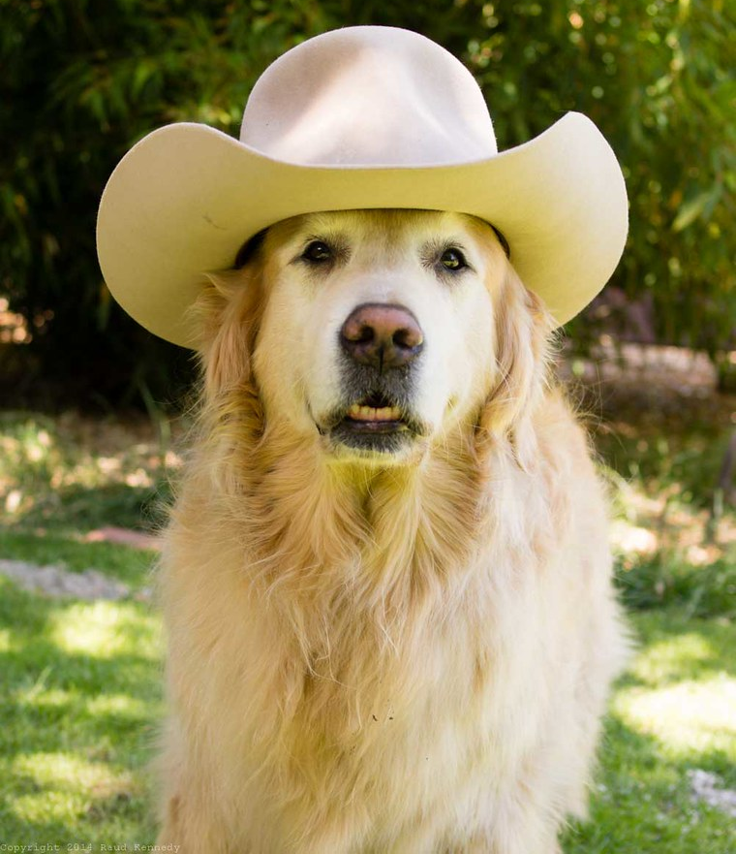
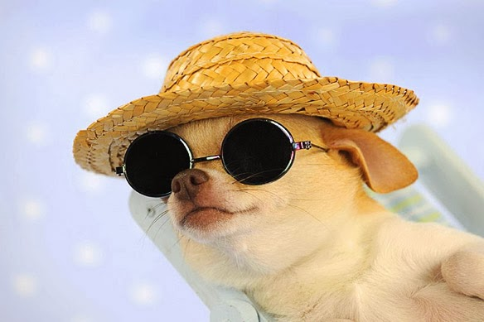
Dogs vary in size, shape, color, and behavior

Slide 4
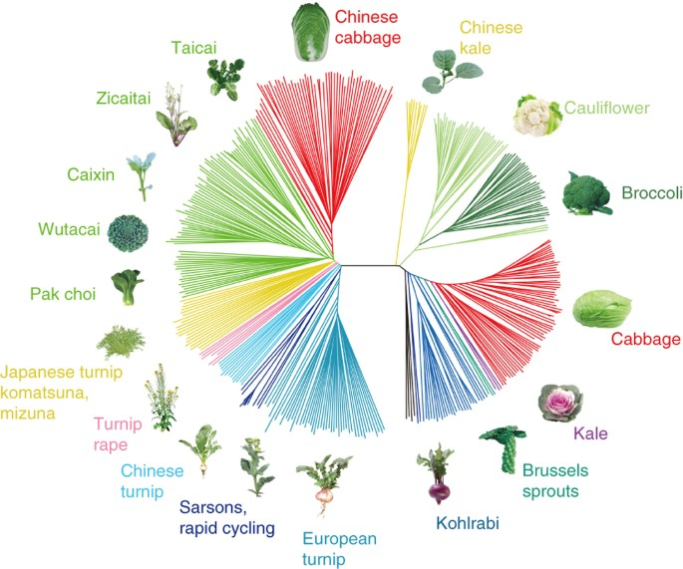
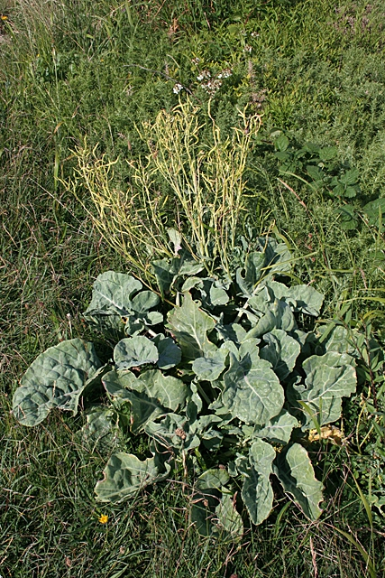
Cabbage domestication
Brassica oleracea and Brassica rapa
Native to coastal southern and western Europe
Domesticated 3,000 years ago

Slide 5
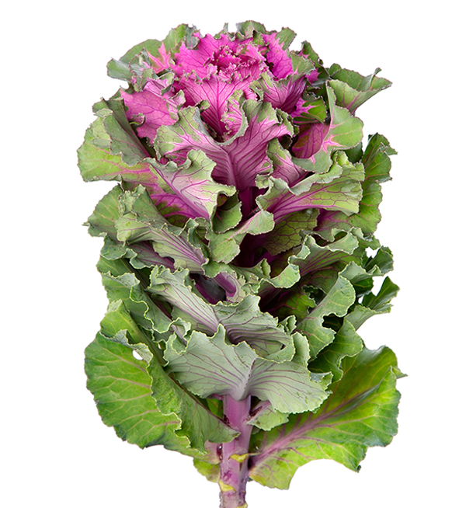
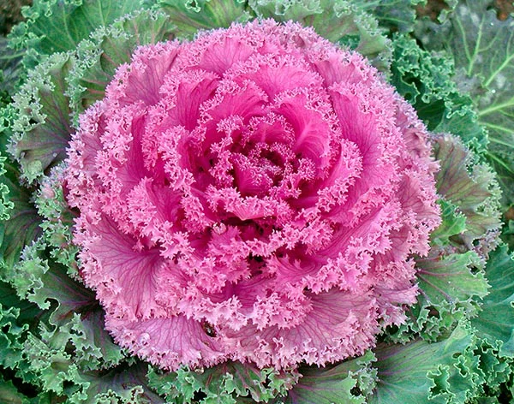
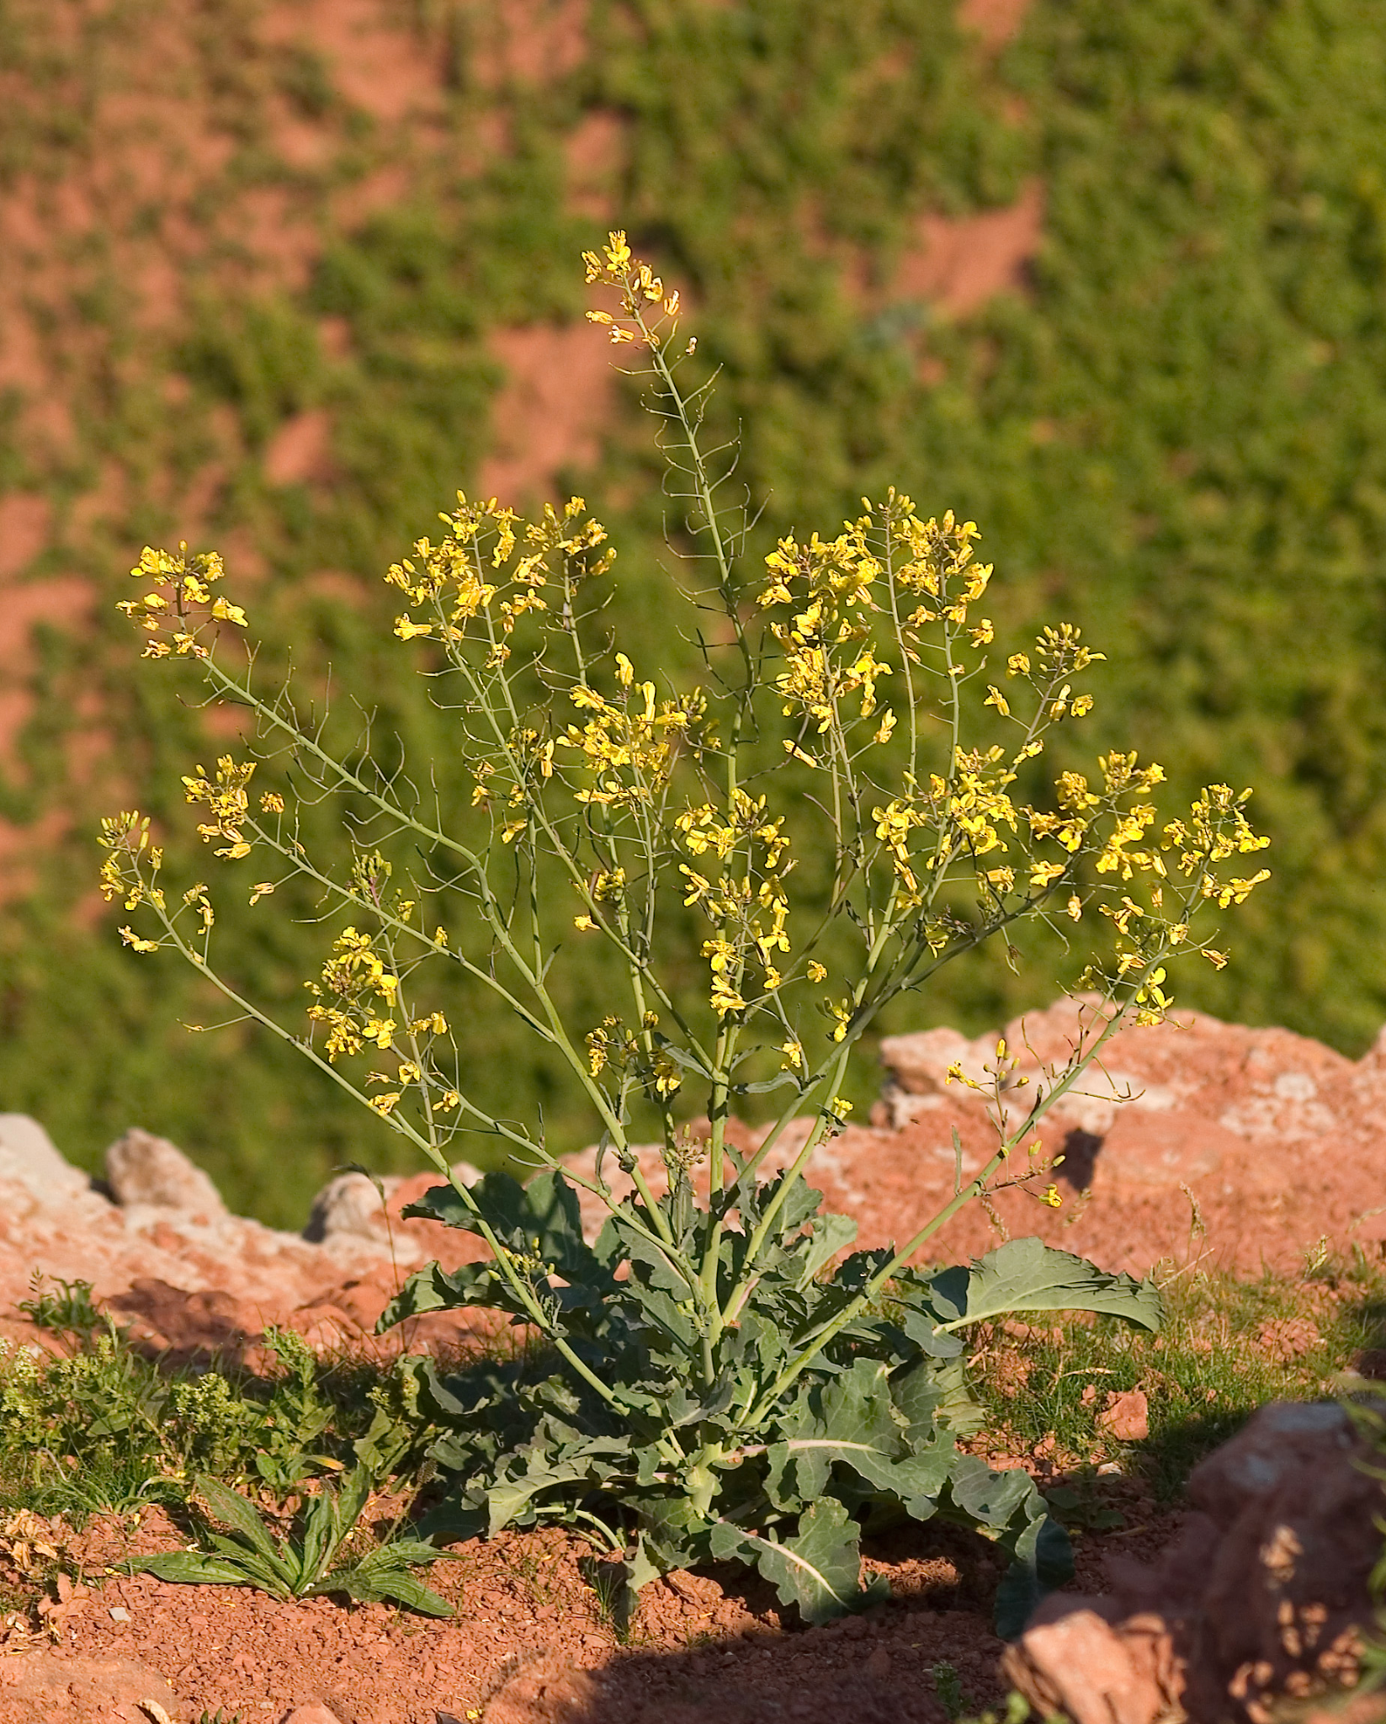
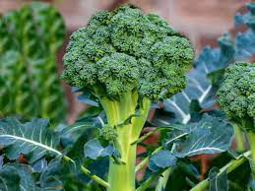
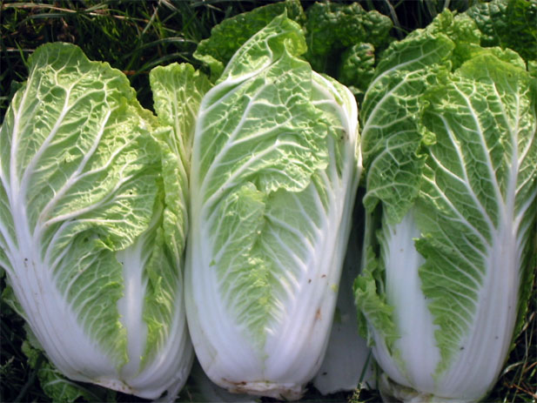
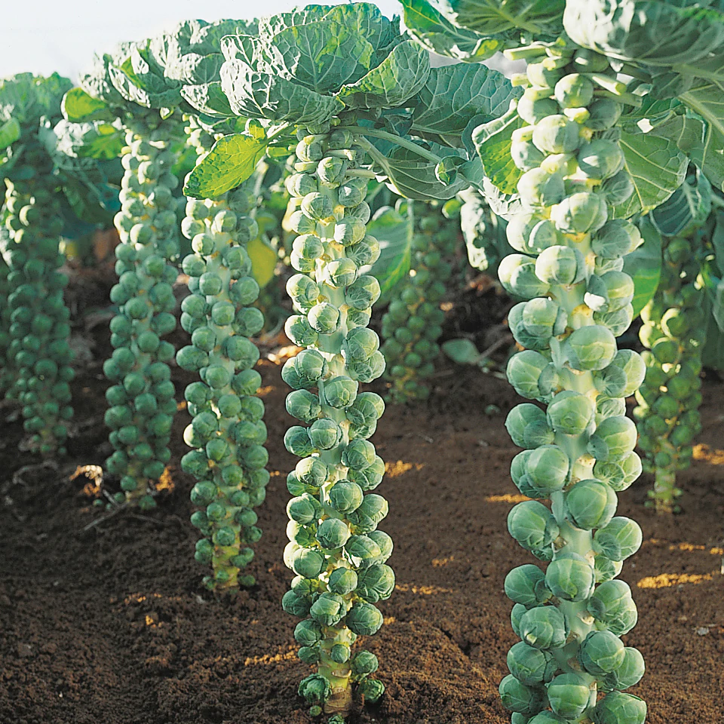
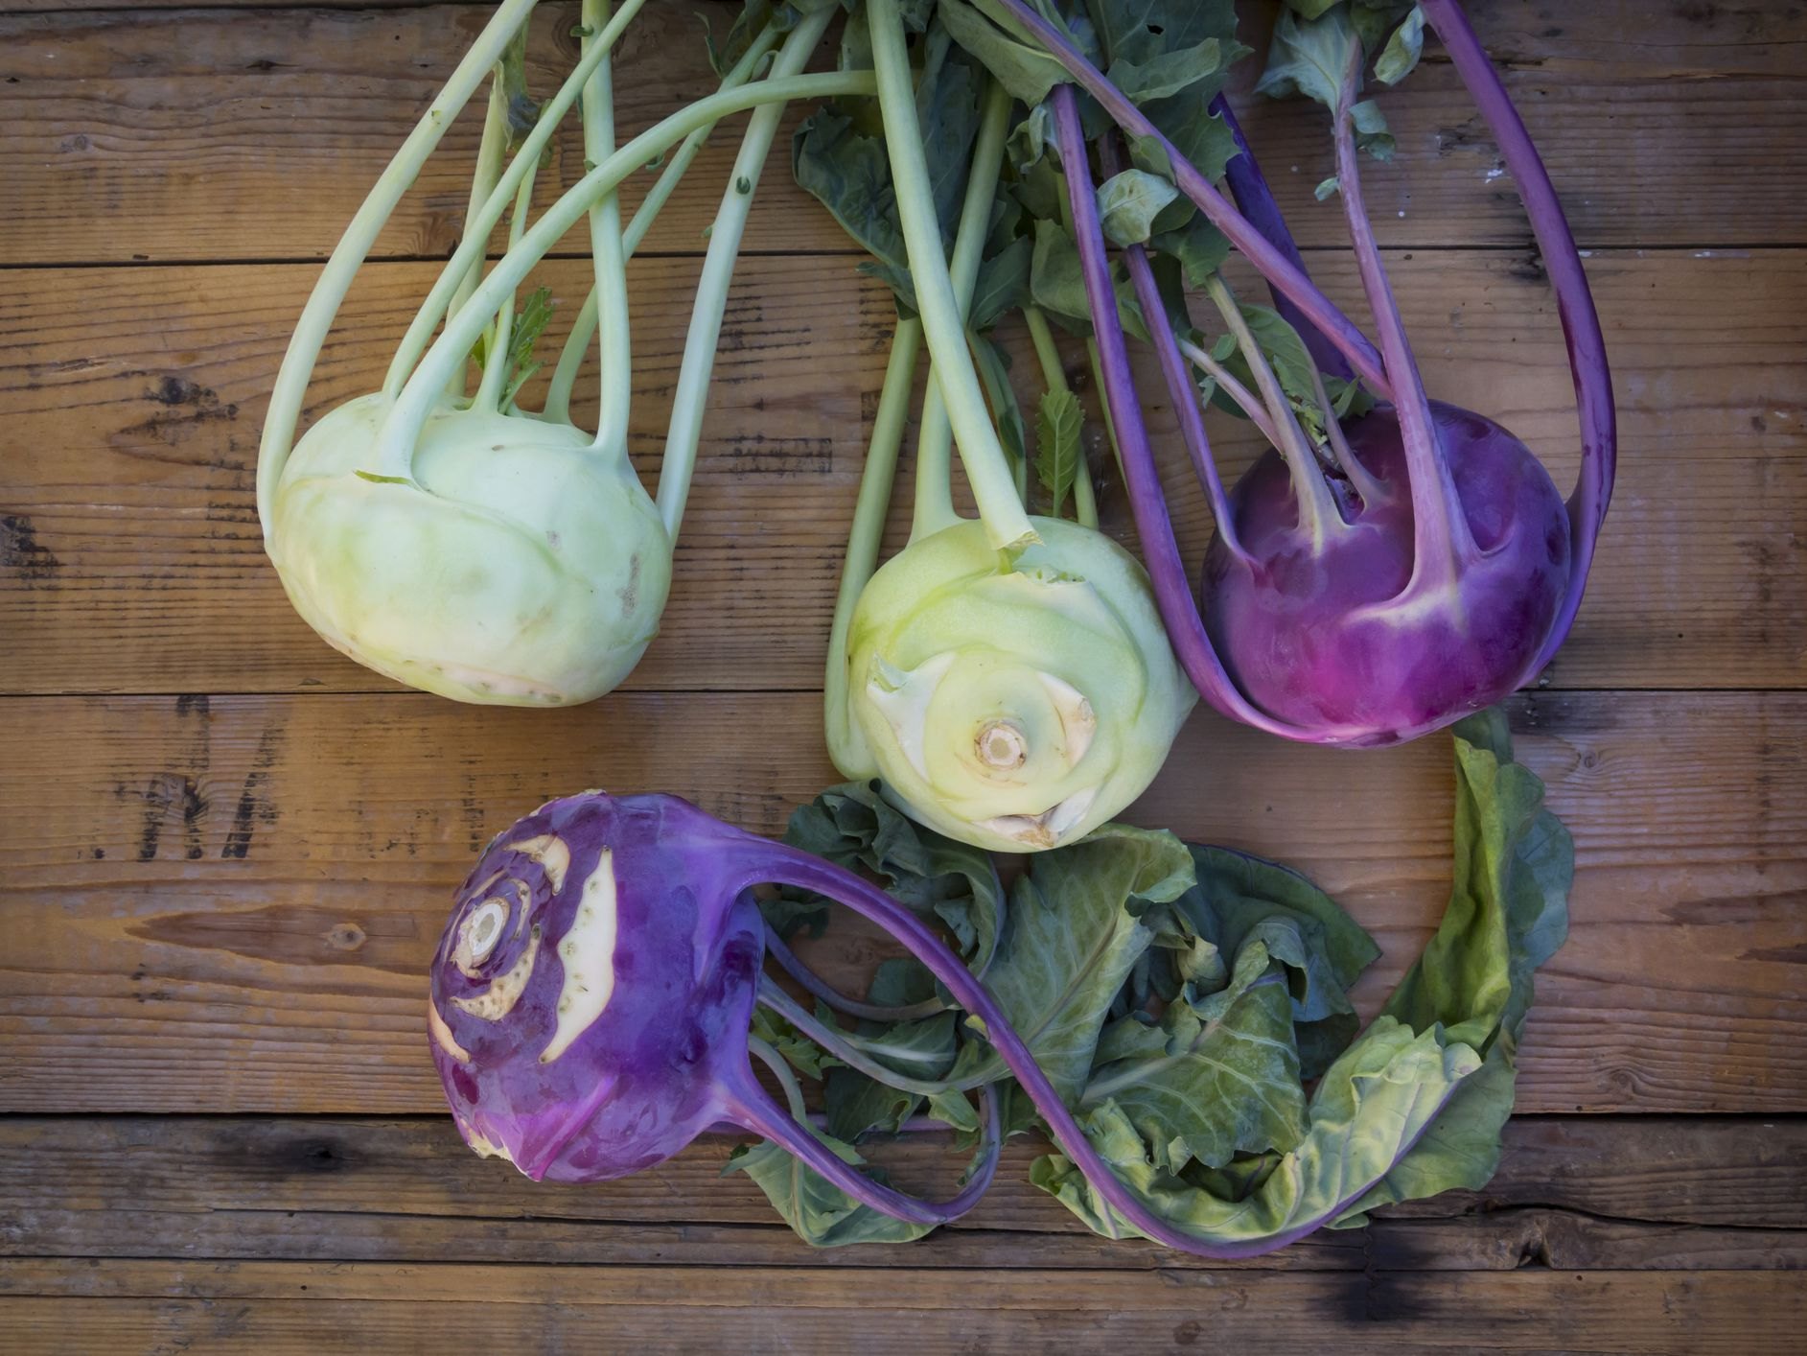
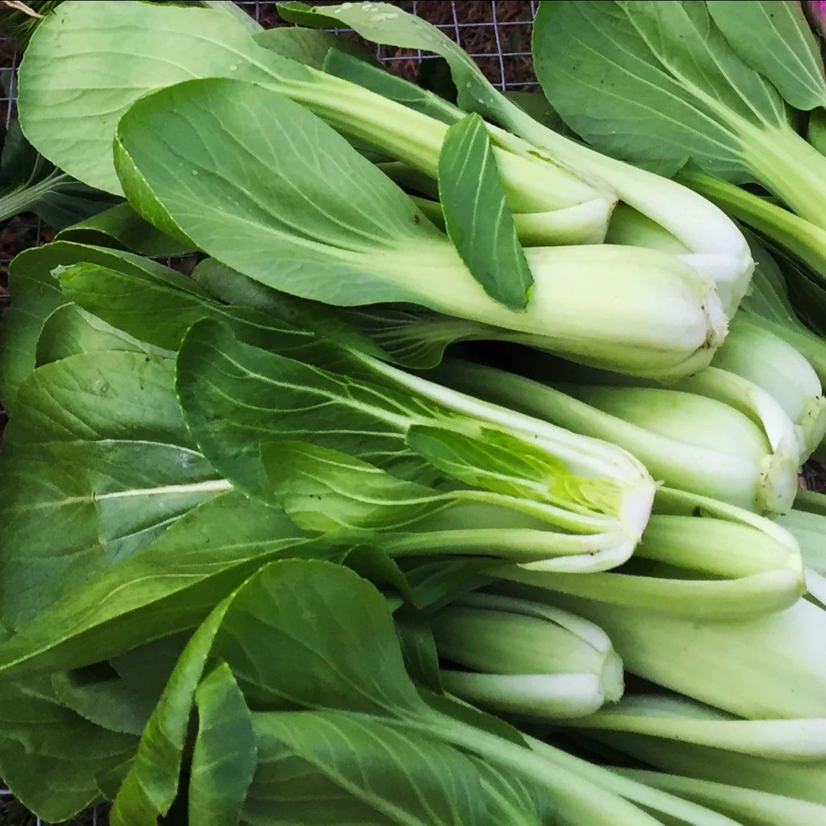
Cabbages vary in size, shape, color, behavior too

Slide 6
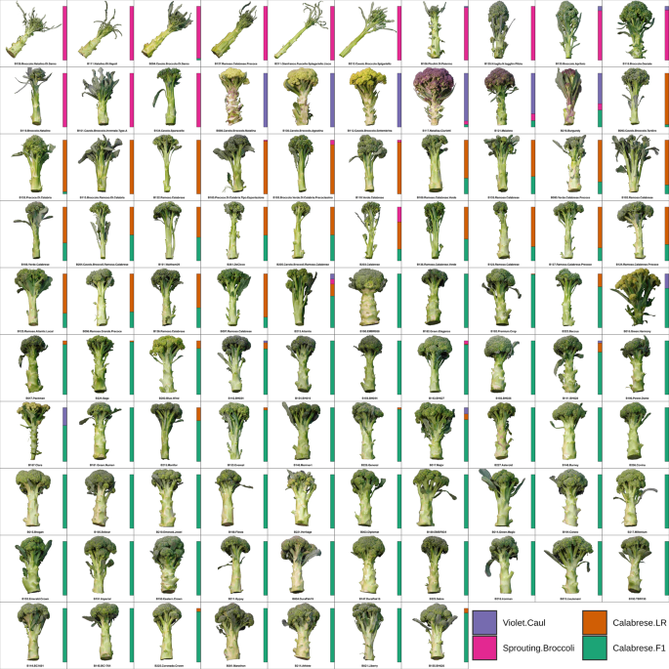
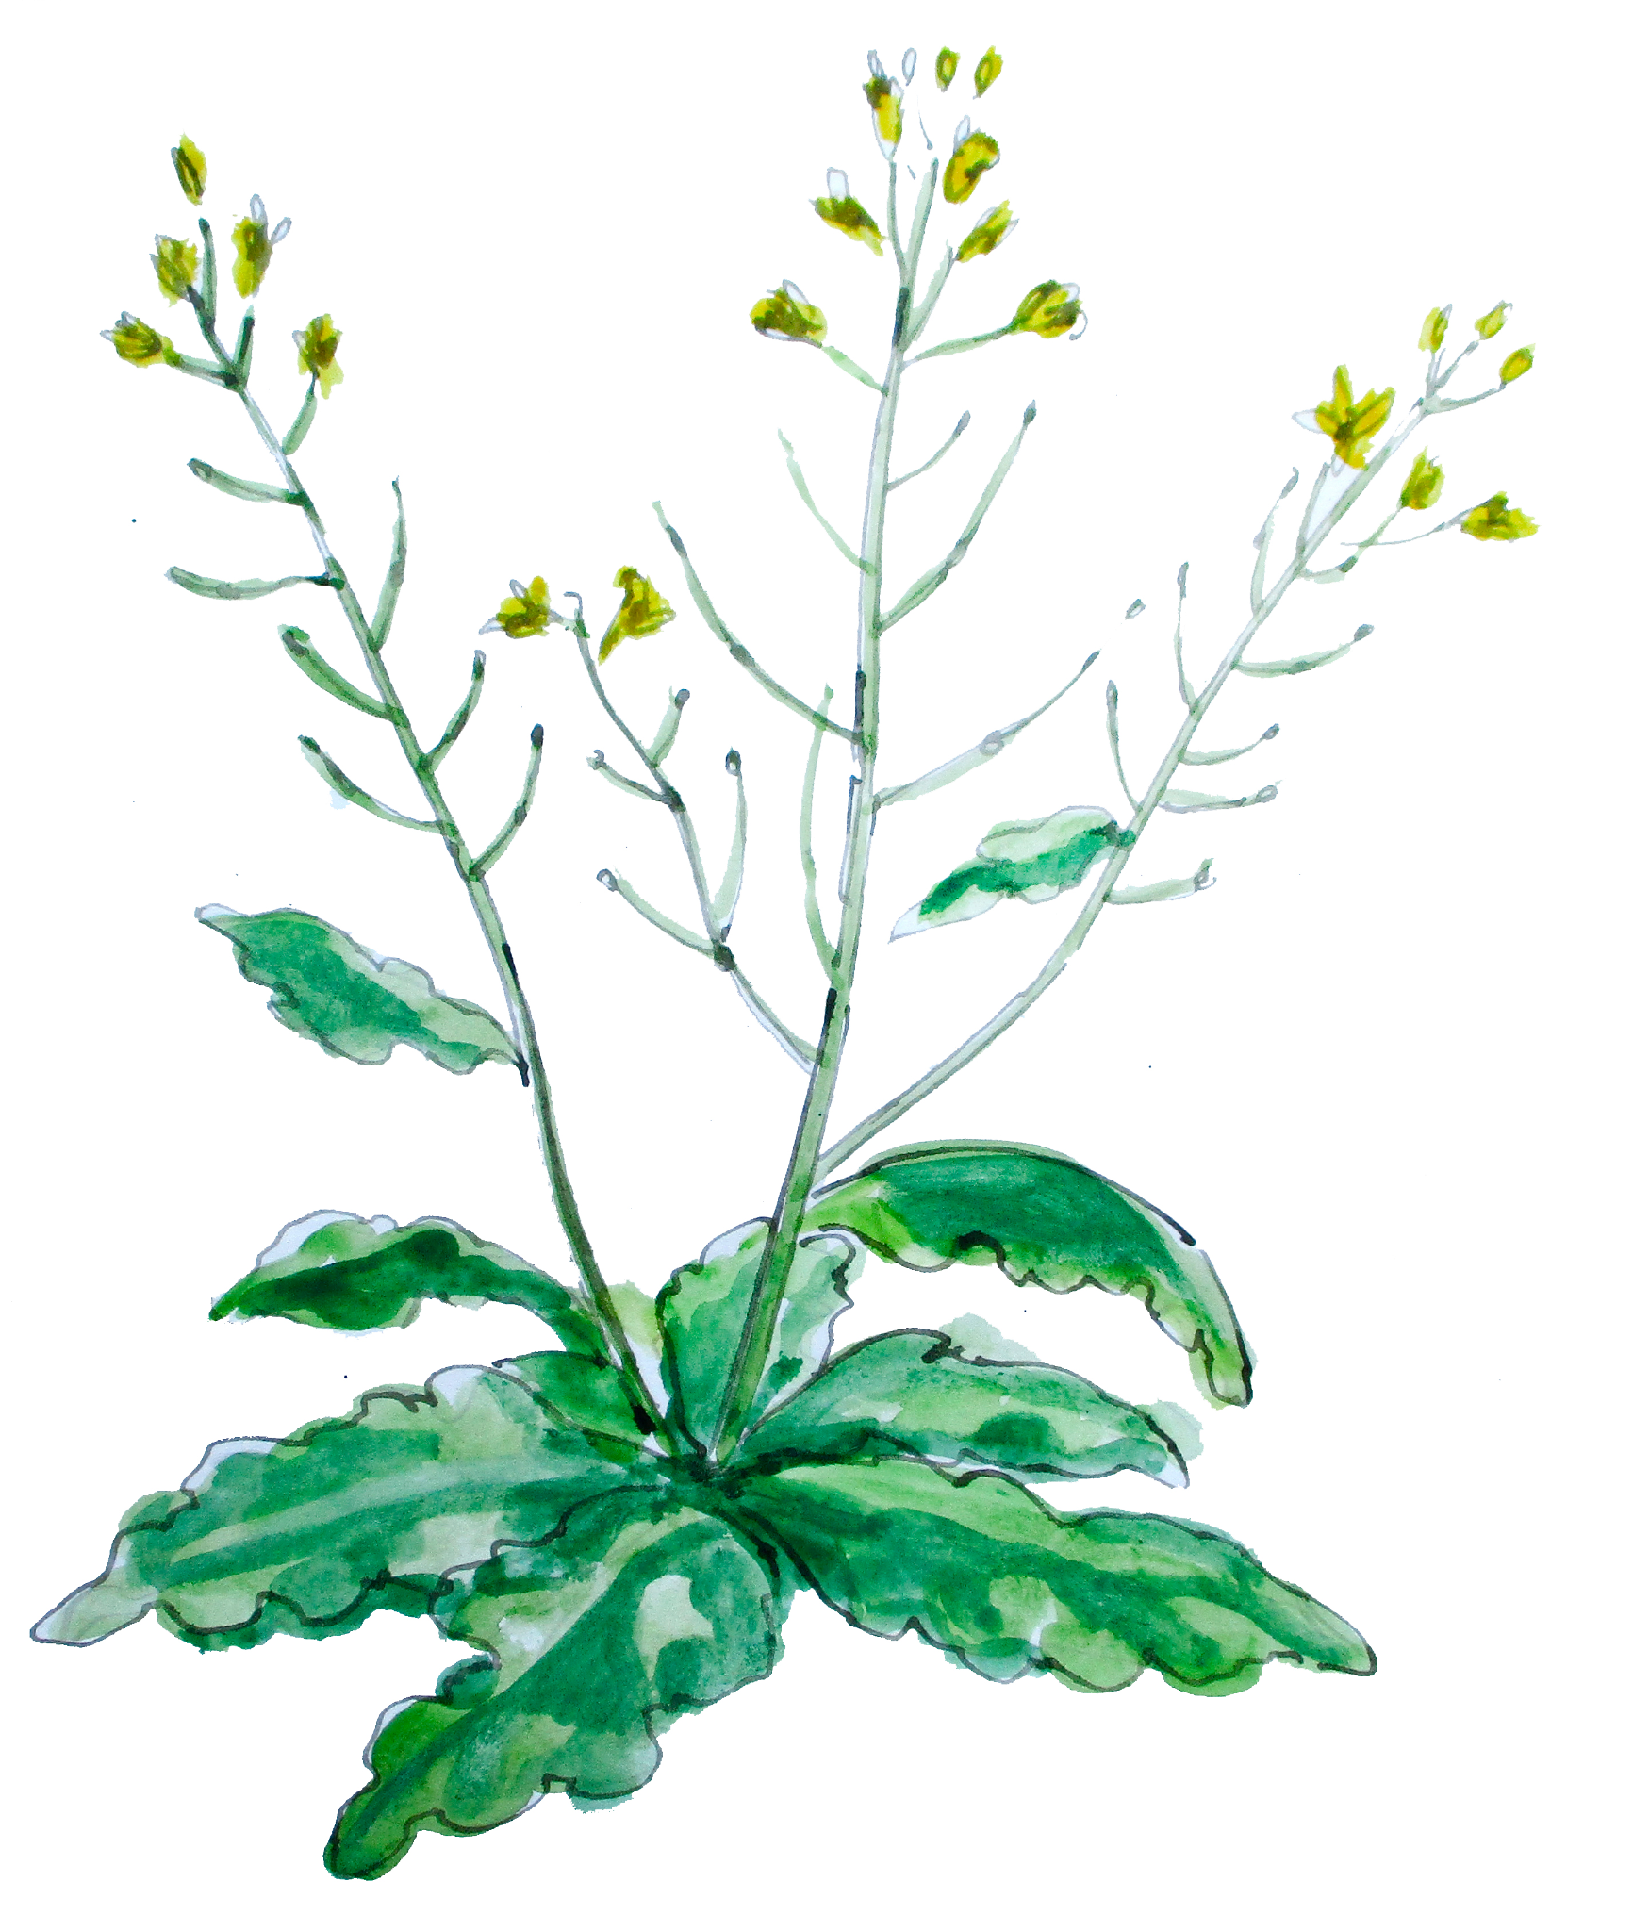
Huge variation in broccoli shapes

Slide 7
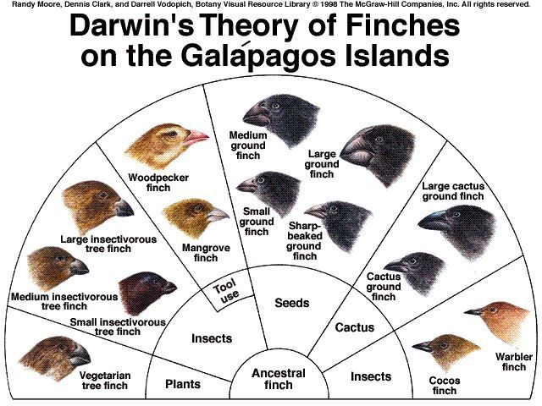
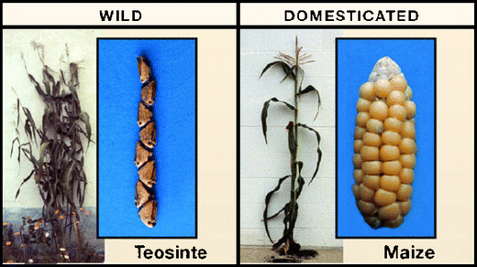
Natural vs artificial/human selection

Slide 8
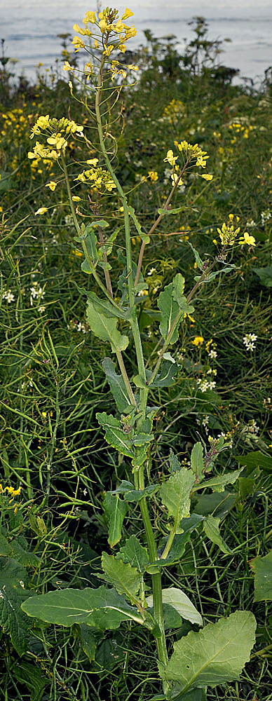
Let’s become cabbage detectives
Goal: Determine what part of of wild Brassica/cabbage modern cabbage was selected from.
Hypothesis: Different cabbages and their cousins were all selected from different parts of the wild cabbage plant.
Methods: Dissect different Brassicas, create a super Brassica with our newfound knowledge.

Slide 9
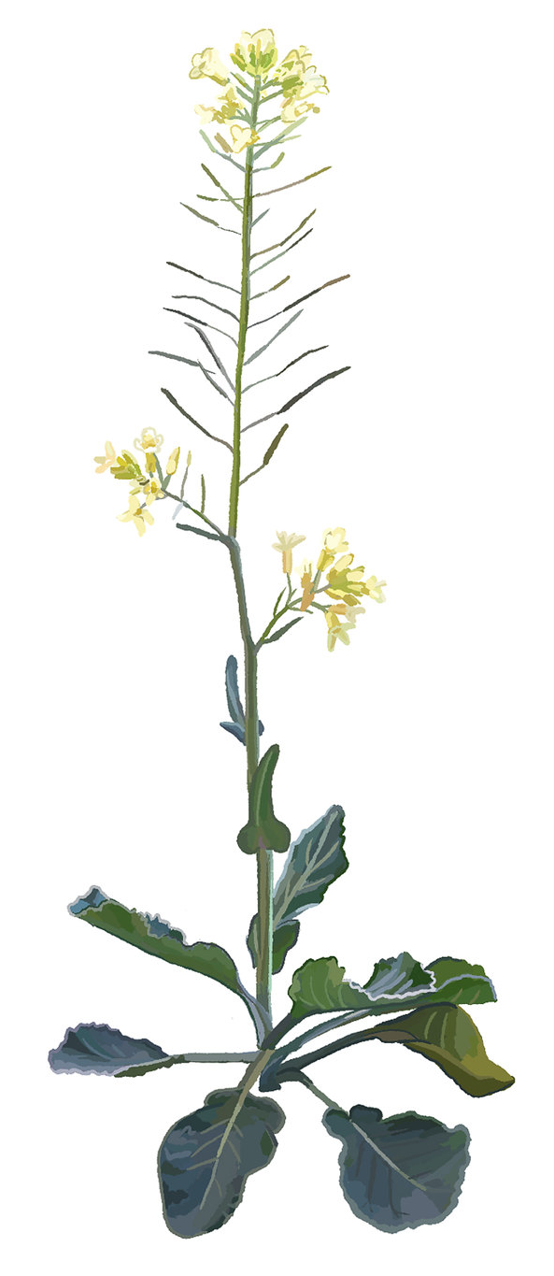
Components of wild cabbage
Flowers (terminal buds)
Flowers - terminal buds
Seeds
Flowers - lateral buds
Stem
Leaves
Roots
Seeds
Flowers (lateral buds)
Stem
Leaves
Roots

Slide 10
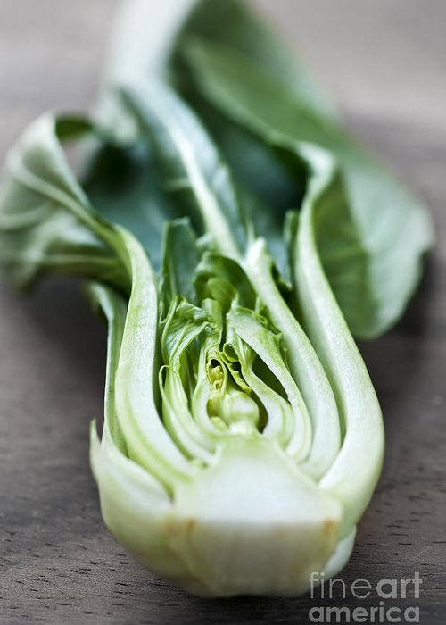
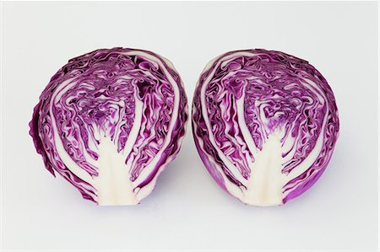
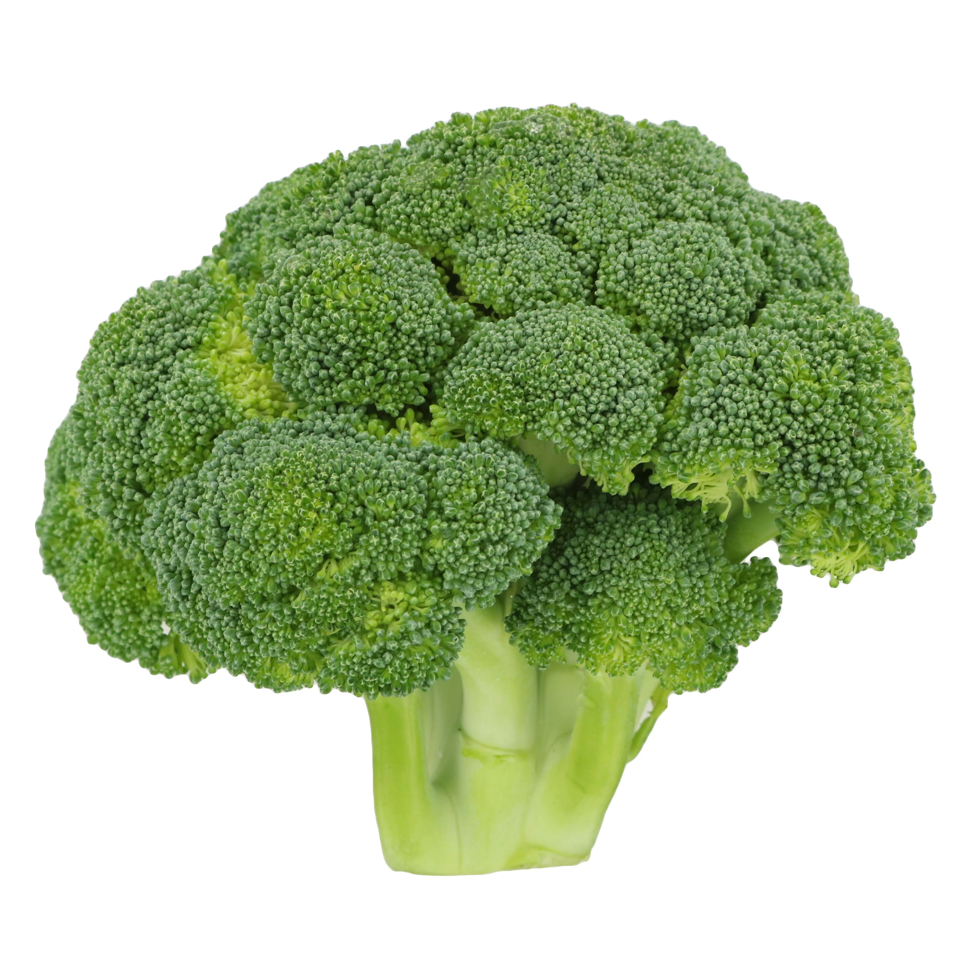
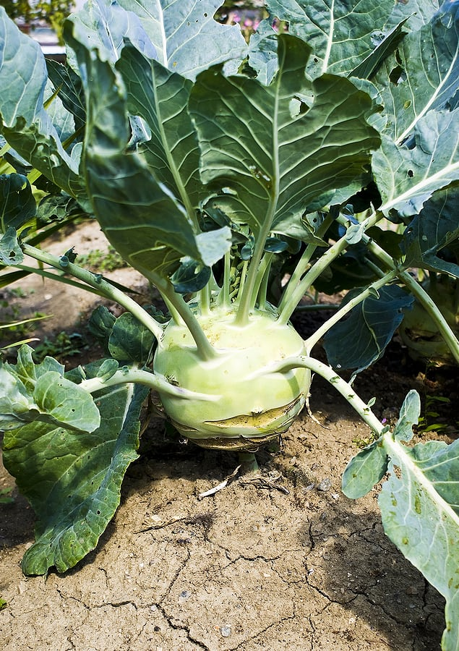
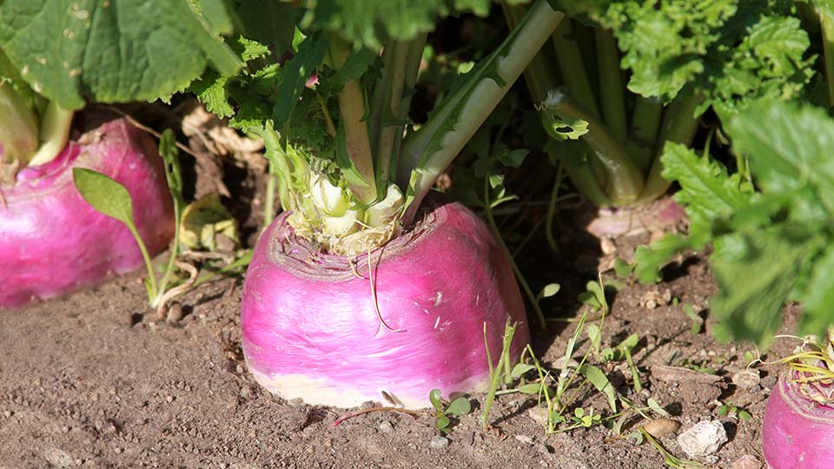
Investigate your plants!
Flowers (terminal buds)
Seeds
Flowers (lateral buds)
Stem
Bok choi
Cabbage
Broccoli
Leaves
Roots
Brussel sprouts
Kohlrabi
Rutabaga

Slide 11
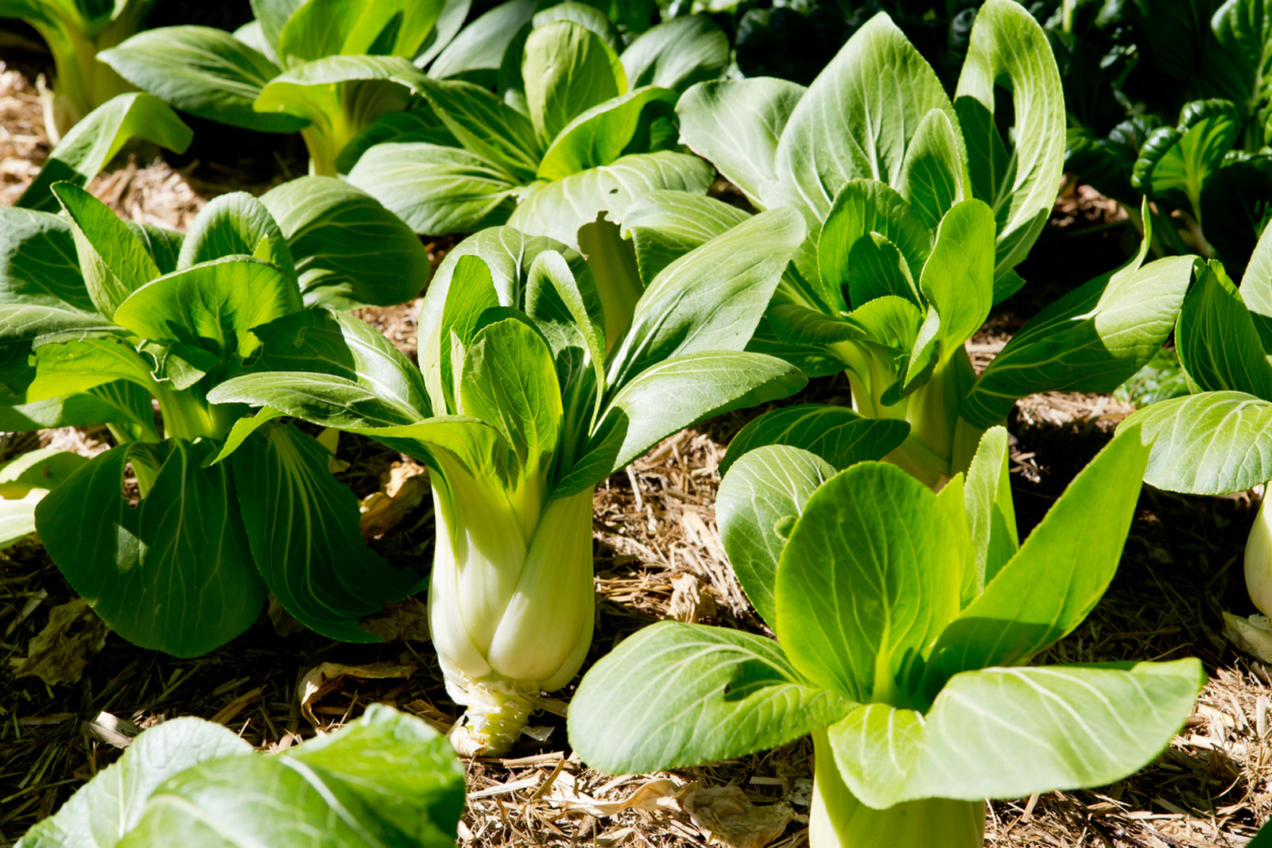
Bok choi
What structures do/don’t we see?
What similar structures are in wild cabbage?
Leaves

Slide 12
Kohlrabi
What structures do/don’t we see?
What similar structures are in wild cabbage?
Stem

Slide 13
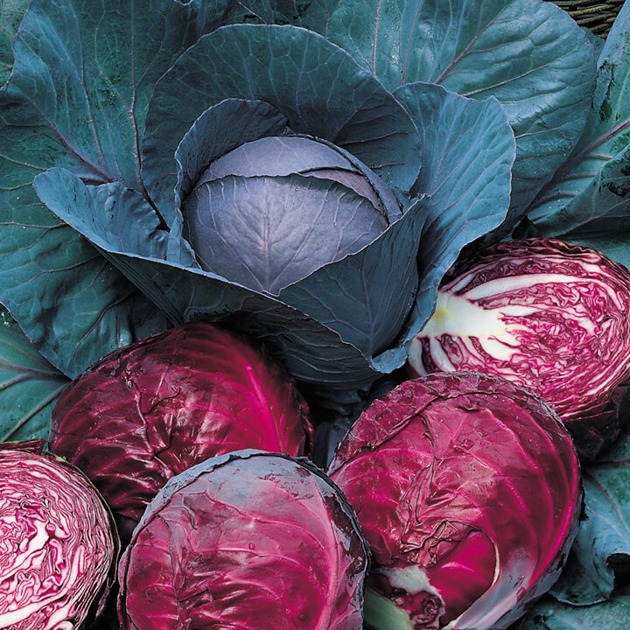
Cabbage
Flowers (terminal buds)
What structures do/don’t we see?
What similar structures are in wild cabbage?

Slide 14
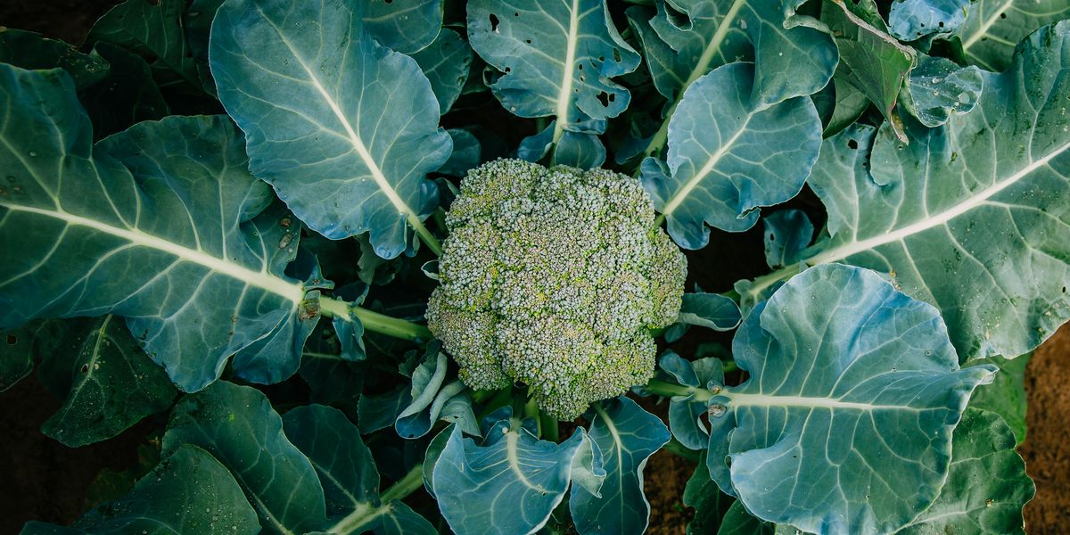
Broccoli/cauliflower
Flowers (terminal buds)
What structures do/don’t we see?
What similar structures are in wild cabbage?

Slide 15
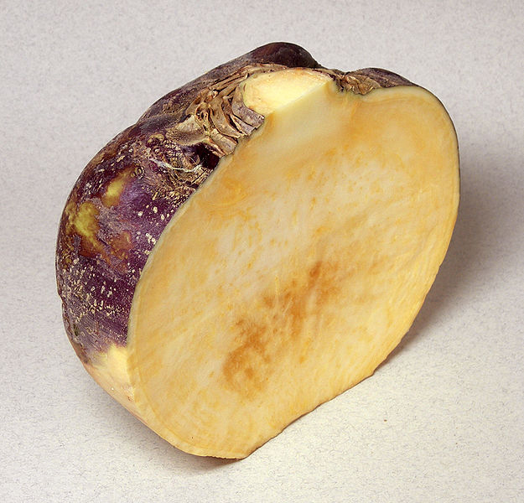
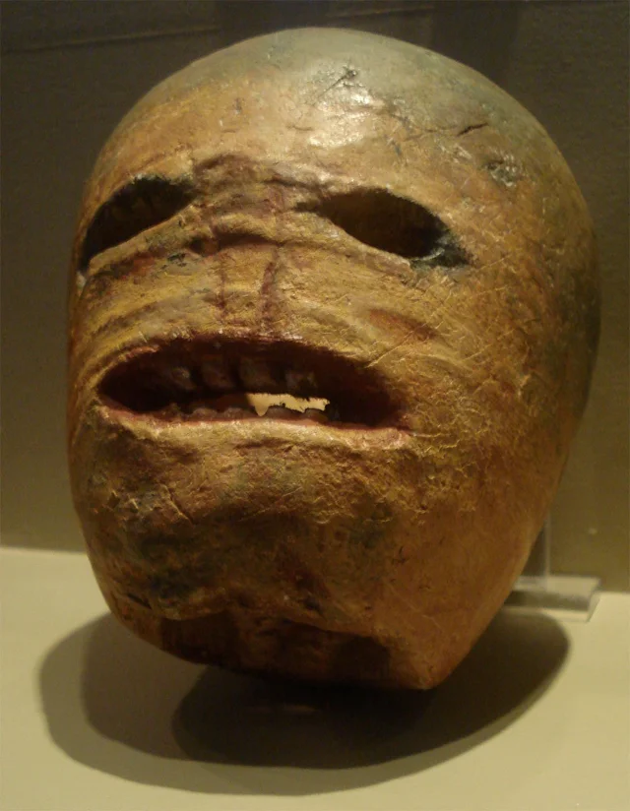
Rutabaga
What structures do/don’t we see?
What similar structures are in wild cabbage?
Stem
Fun fact: the earliest jack-o-lanterns were made out of rutabagas!
Roots

Slide 16
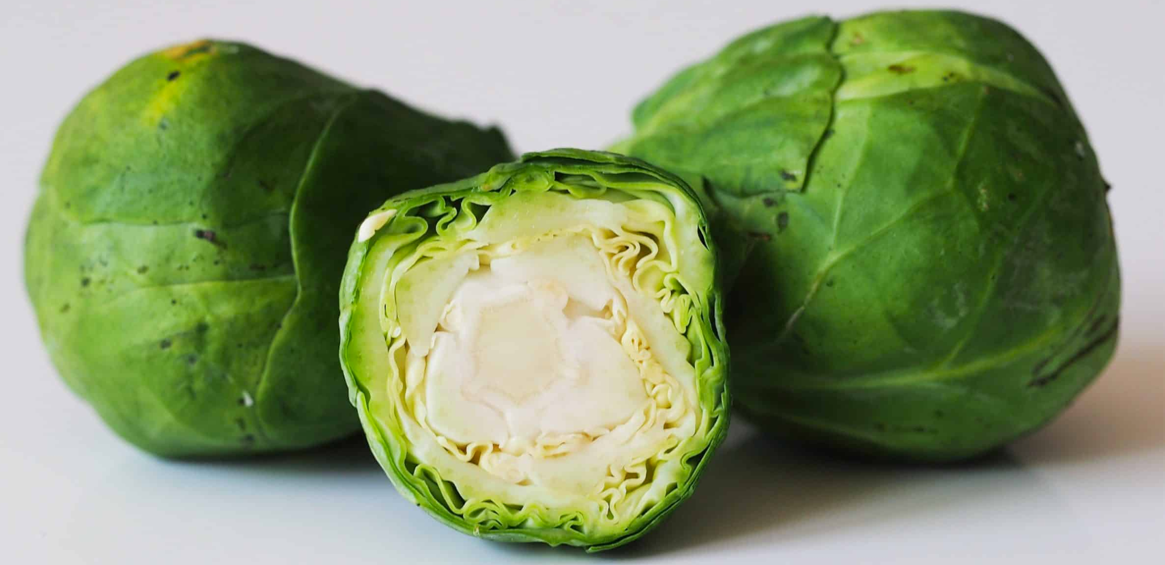
Brussel Sprouts
Flowers (terminal buds)
What structures do/don’t we see?
What similar structures are in wild cabbage?
Seeds
Flowers (lateral buds)
Stem
Leaves
Roots

Slide 17
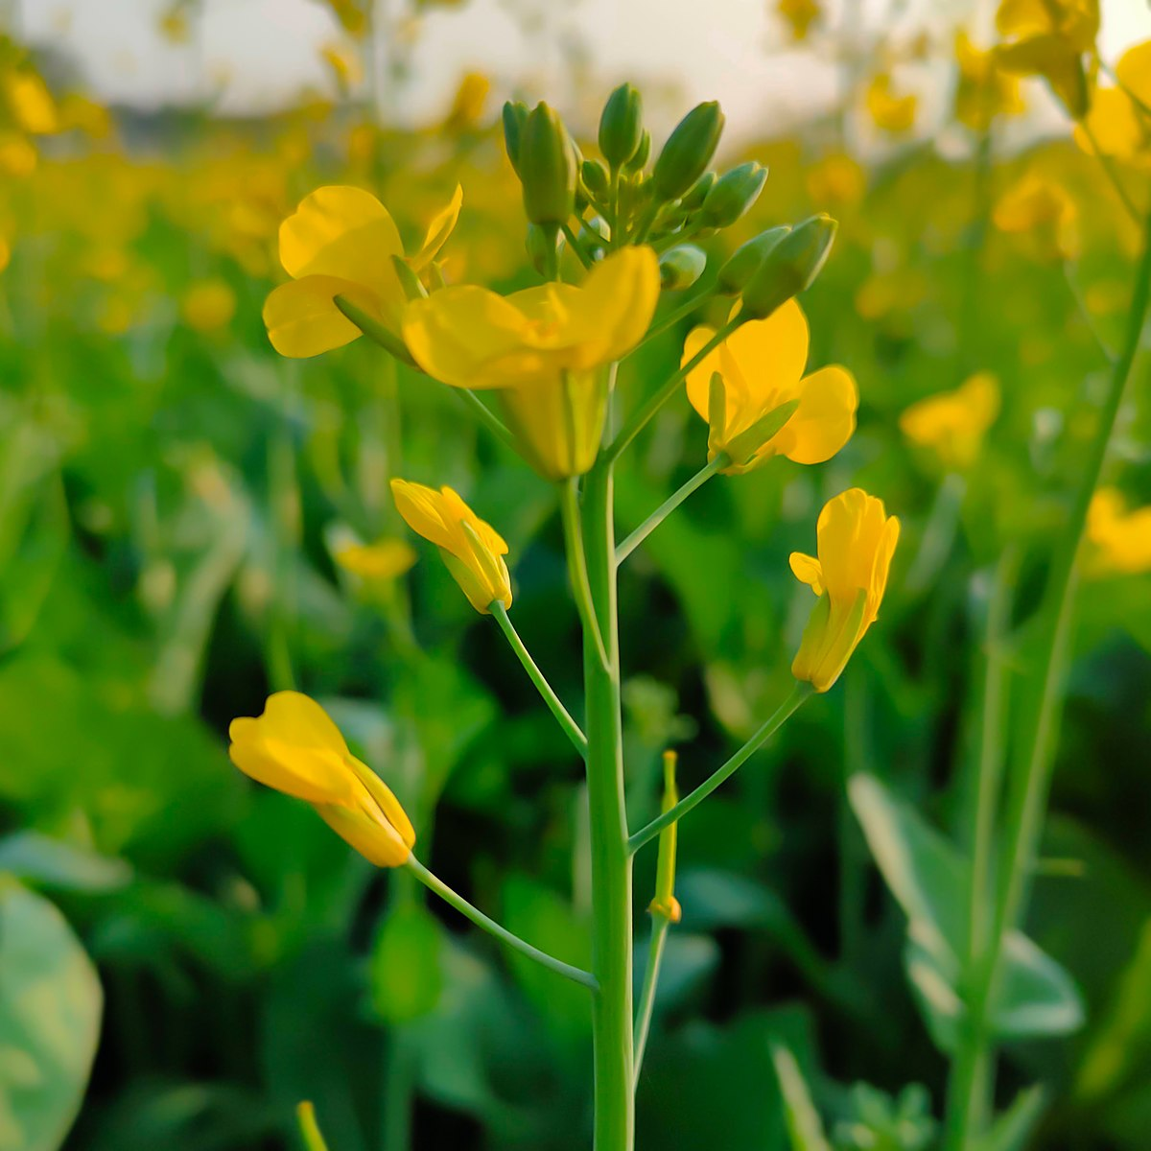
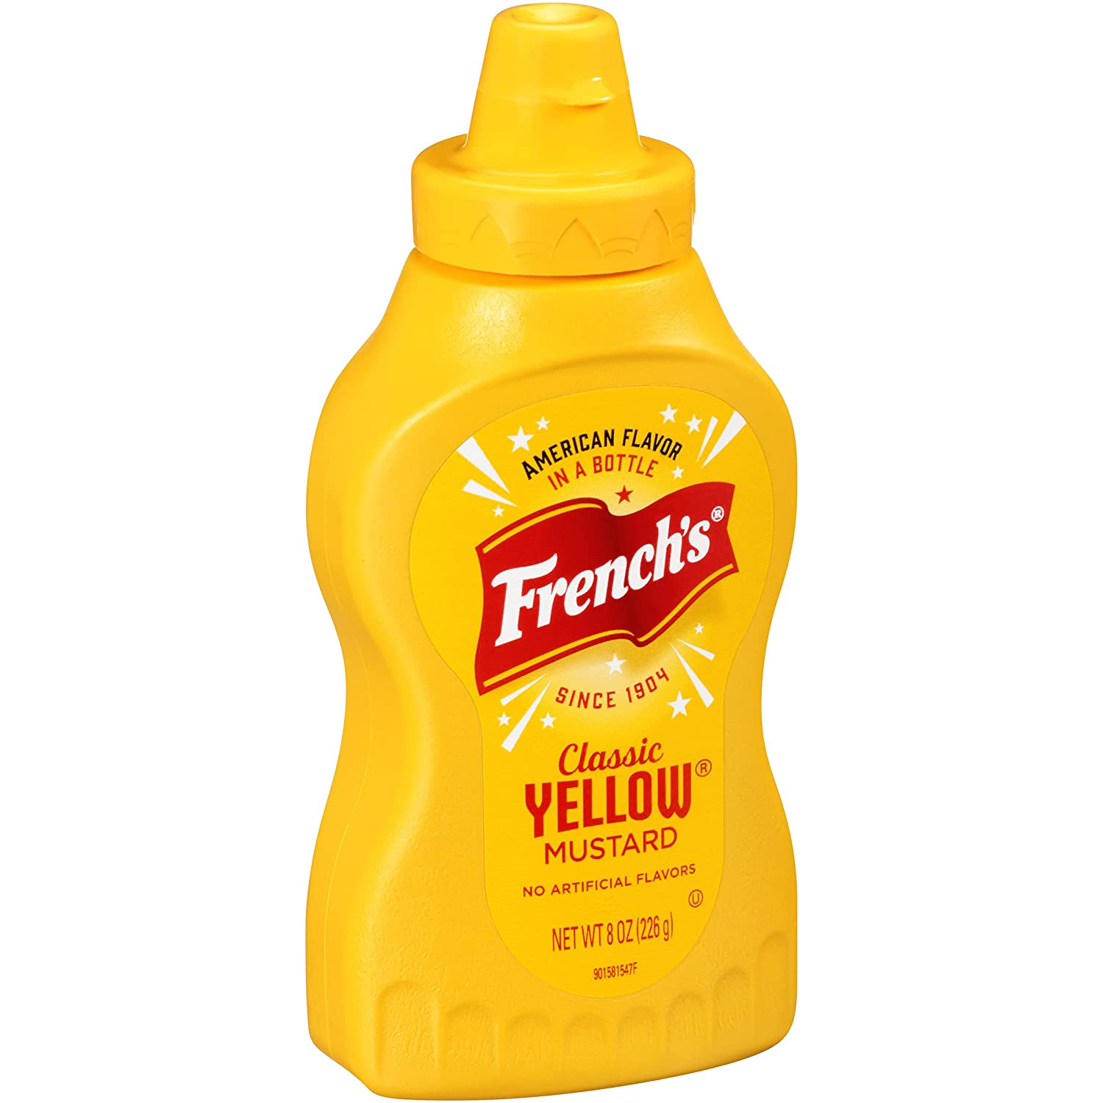
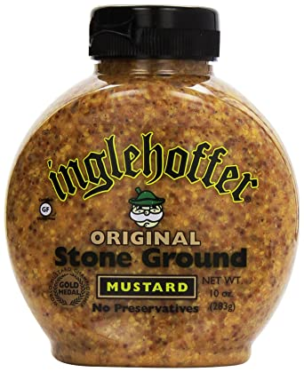
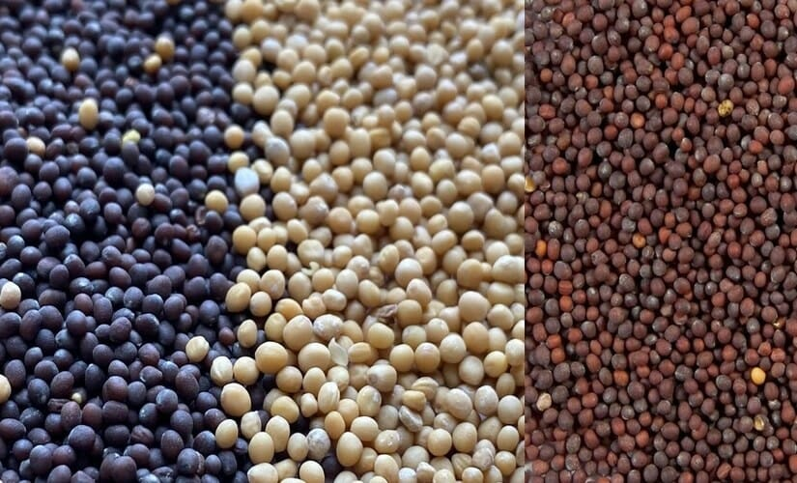
Mustard
What structures do/don’t we see?
What similar structures are in wild cabbage?
Seeds

Slide 18
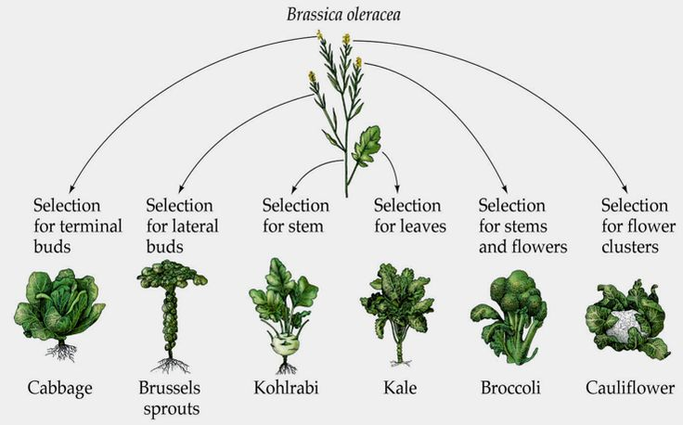

Slide 19
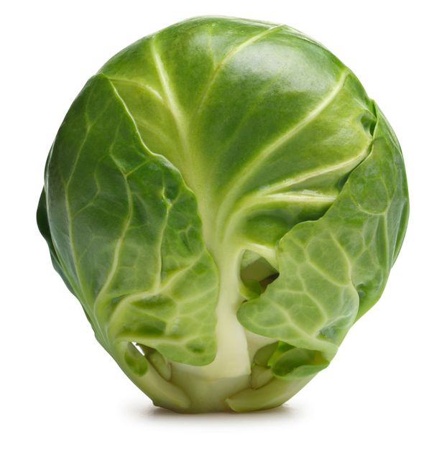
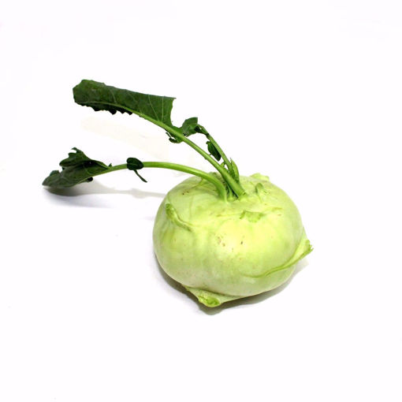
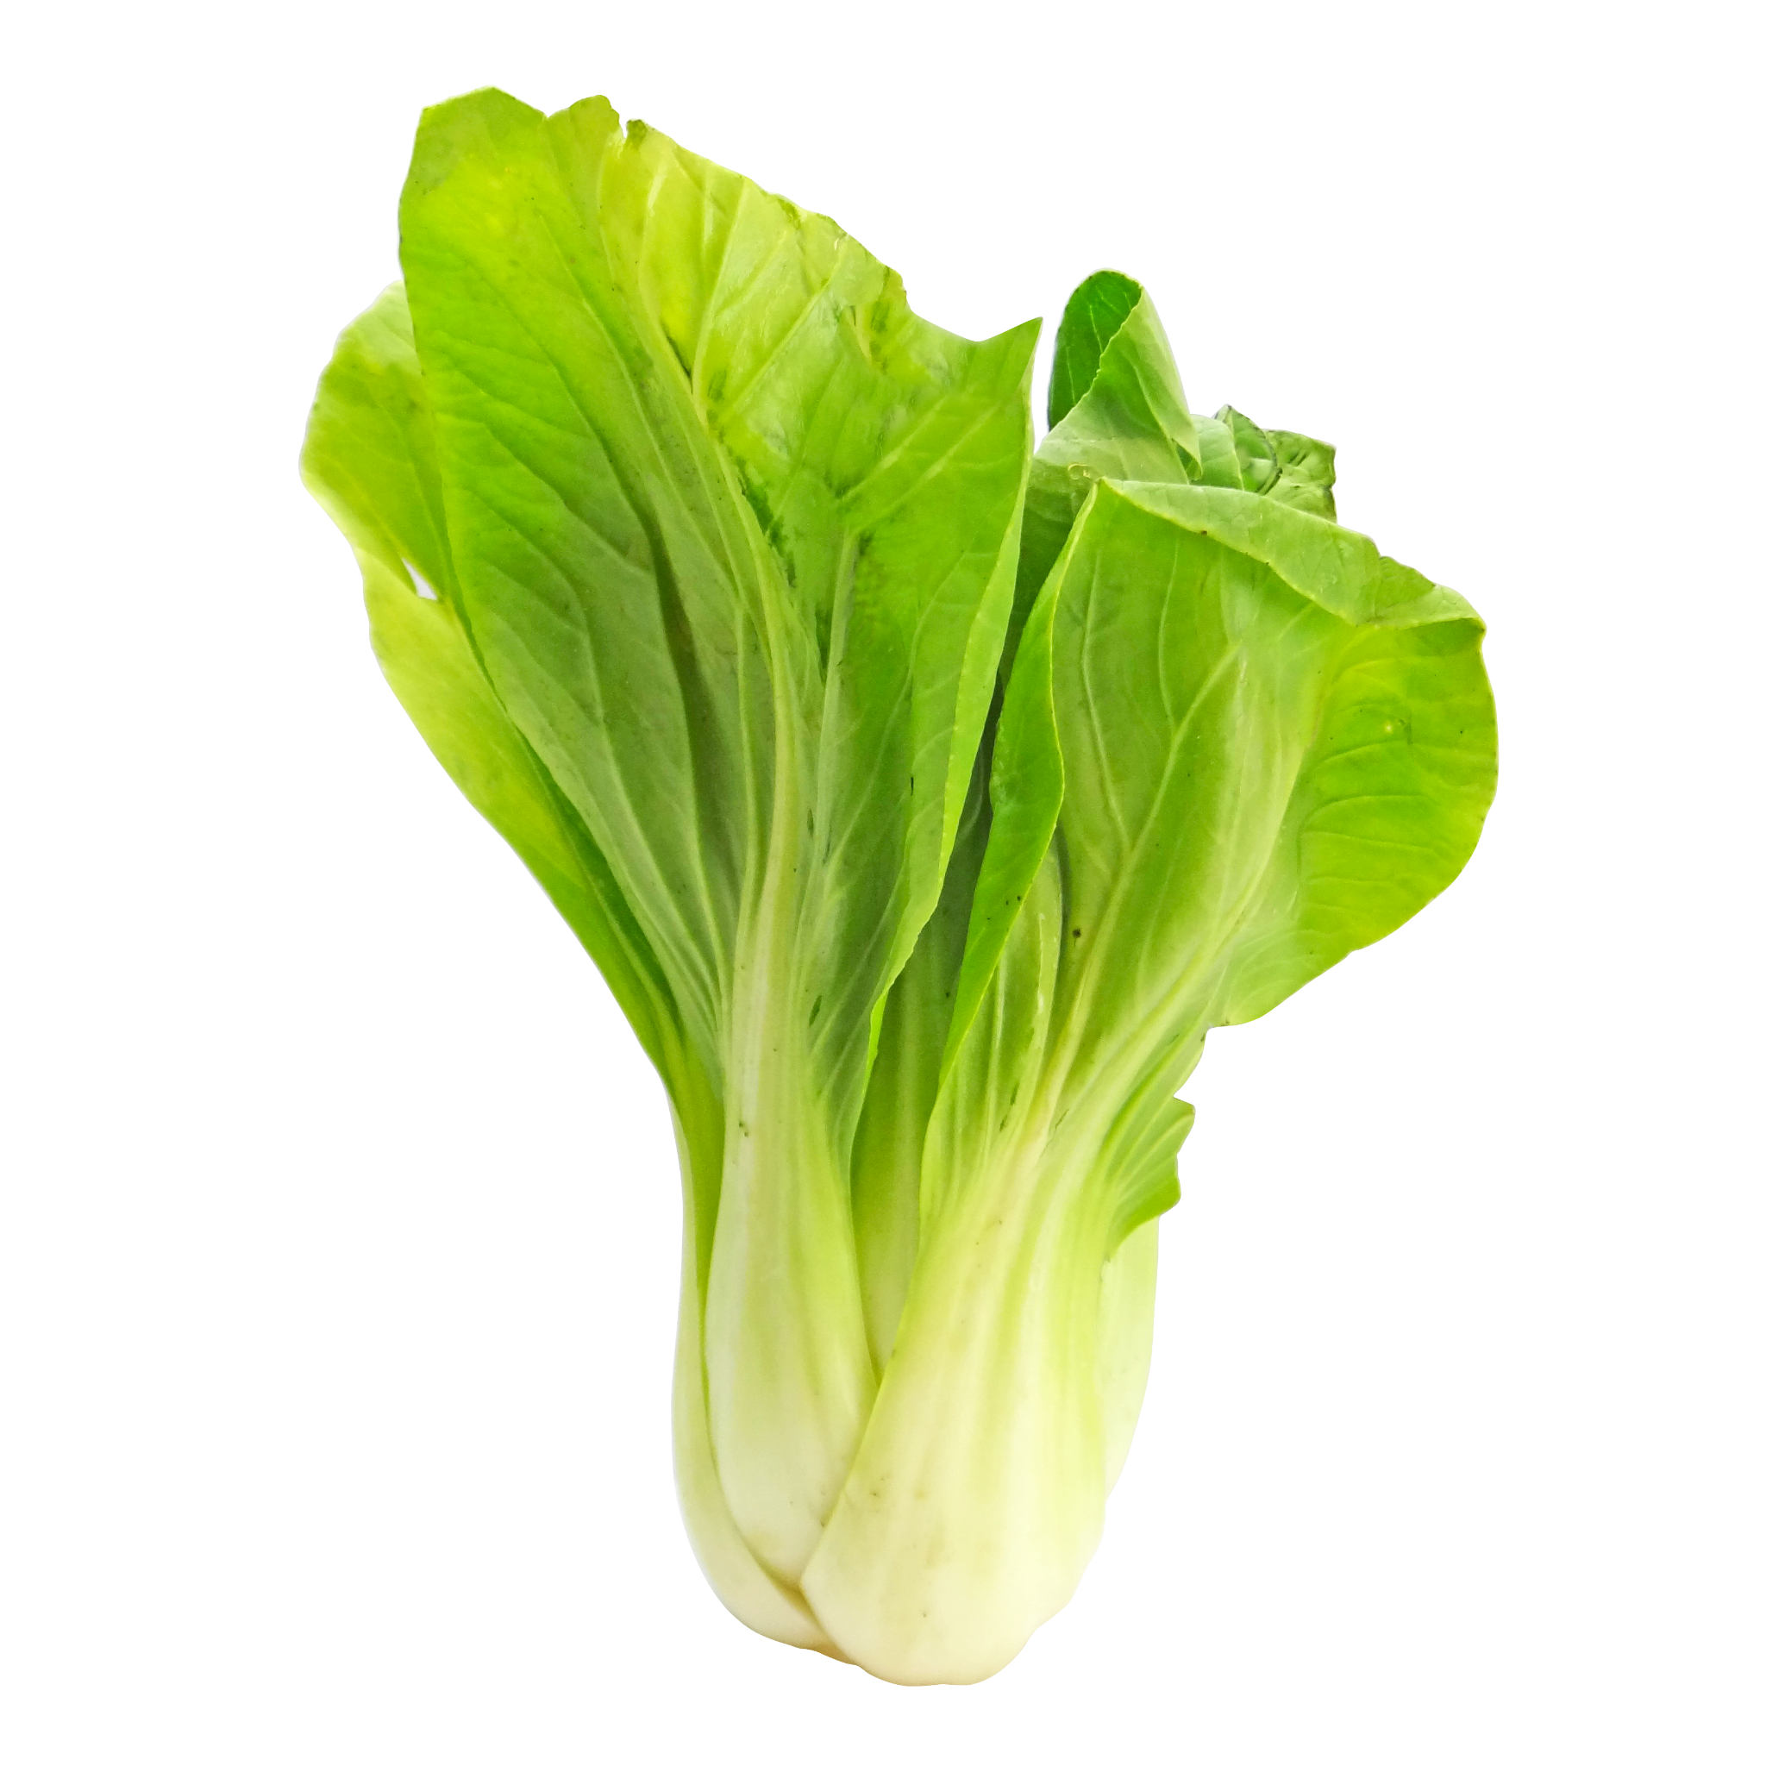
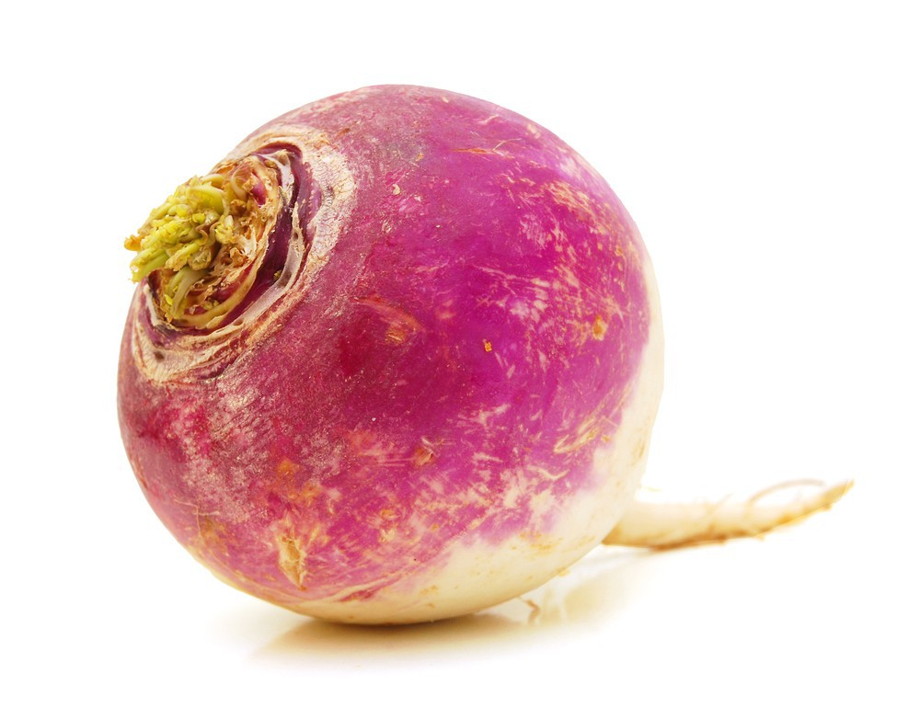
Super Brassica assemble!
Glue mini cabbages onto wild cabbage
Selection on:
Flowers (terminal buds)
Artificial selection
Flowers (lateral buds)
Stem
Leaves
Roots
Wild cabbage
(Brassica oleracea)
Super cabbage
(Brassica super)

Slide 20
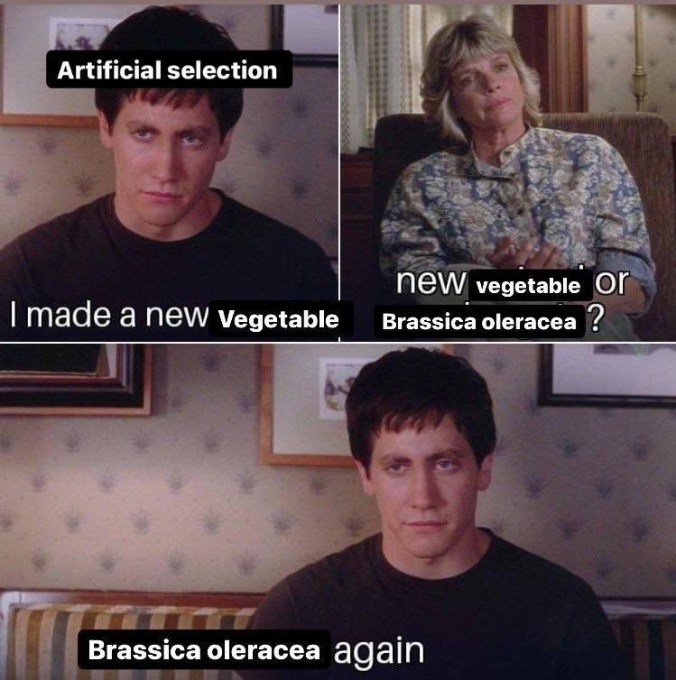
Thanks!
Any questions?

